Slide 1

Financial Literacy Support Application
Educating children and adults through interactive games.

Slide 2

The Problem
1
Financial Illiteracy
2
Ineffective Education
Poor choices lead to debt and lack of savings.
Traditional methods fail to engage learners effectively.
3
Accessibility Gap
Need for interactive tools across age groups.

Slide 3




Our Solution
Interactive Gaming
Engaging scenarios for practical financial learning.
Real-life Simulations
Users navigate financial decisions and outcomes.
Age-Adapted Content
Tailored experience for children and adults.

Slide 4
Target Audience
Children (8-15)
Adults
Building financial foundations through age-appropriate content.
Enhancing financial literacy for better decision-making.

Slide 5

Game Mechanics
1
Story-Driven Simulation
Users make decisions in realistic financial scenarios.
2
Consequence System
Choices affect in-game financial health and progress.
3
Immediate Feedback
Users learn from outcomes of their decisions.

Slide 6

Key Benefits
Critical Thinking
Concept Mastery
Develop financial decision-making skills through practice.
Understand savings, investments, budgeting, and debt management.
Practical Application
Gain knowledge that translates to real-life financial habits.

Slide 7
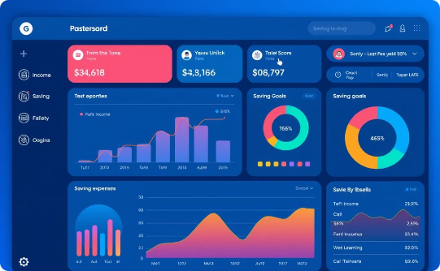

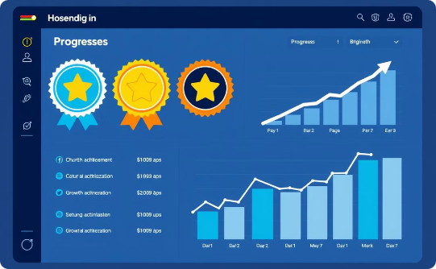
Application Features
Dashboard
Life Events
Progress Tracking
Track financial status and progress.
Navigate financial challenges and opportunities.
Visualize goal achievement and financial growth.

Slide 8




Technology Stack
Frontend
React for responsive and interactive user interface.
Backend
Node.js powering robust server-side operations.
Design
User-centric approach for intuitive navigation and accessibility.

Slide 9

Join Our Mission
Empower users
Improve financial literacy globally
Collaborate
Provide feedback and suggestions
Share
Spread financial education

